Slide 1

Coloring
http://vr.vex.com

Slide 2
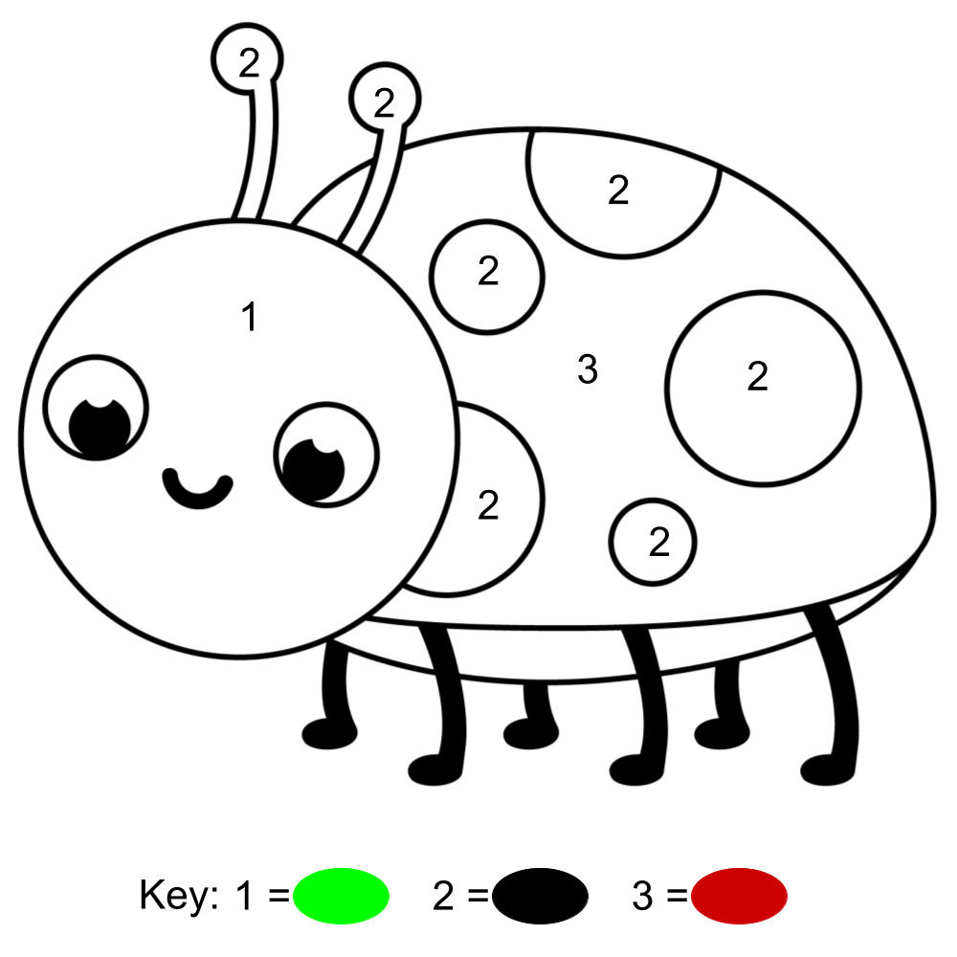
Drawing Level 1

Slide 3
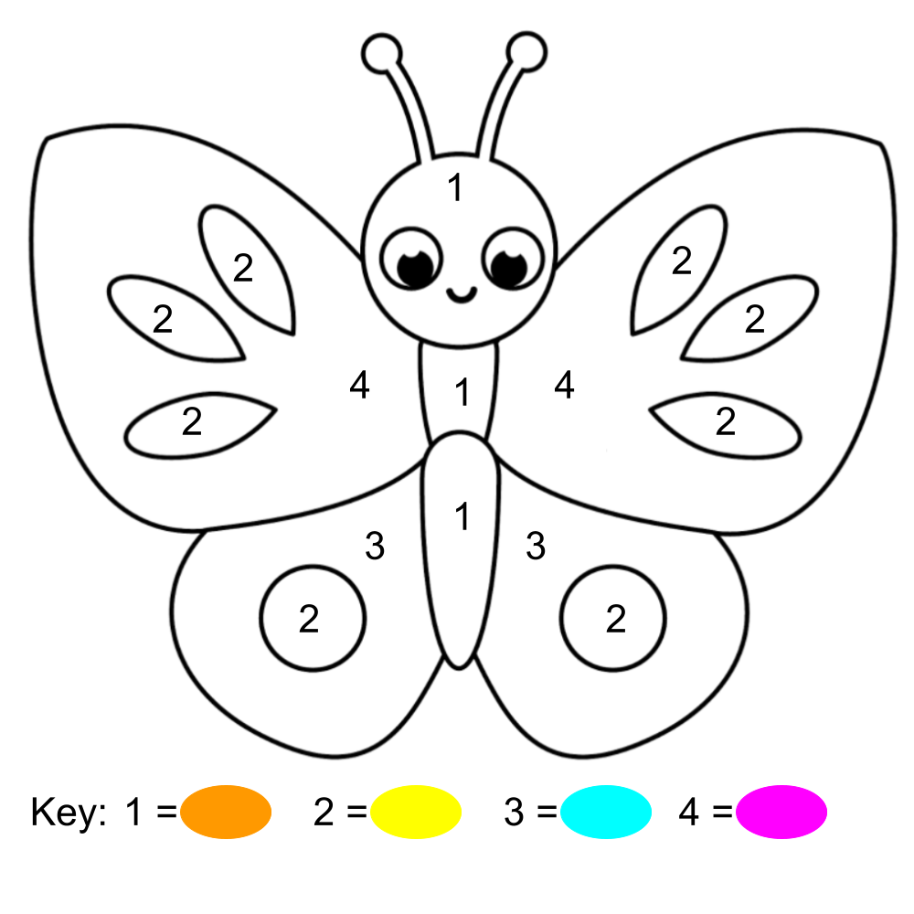
Drawing Level 2

Slide 4
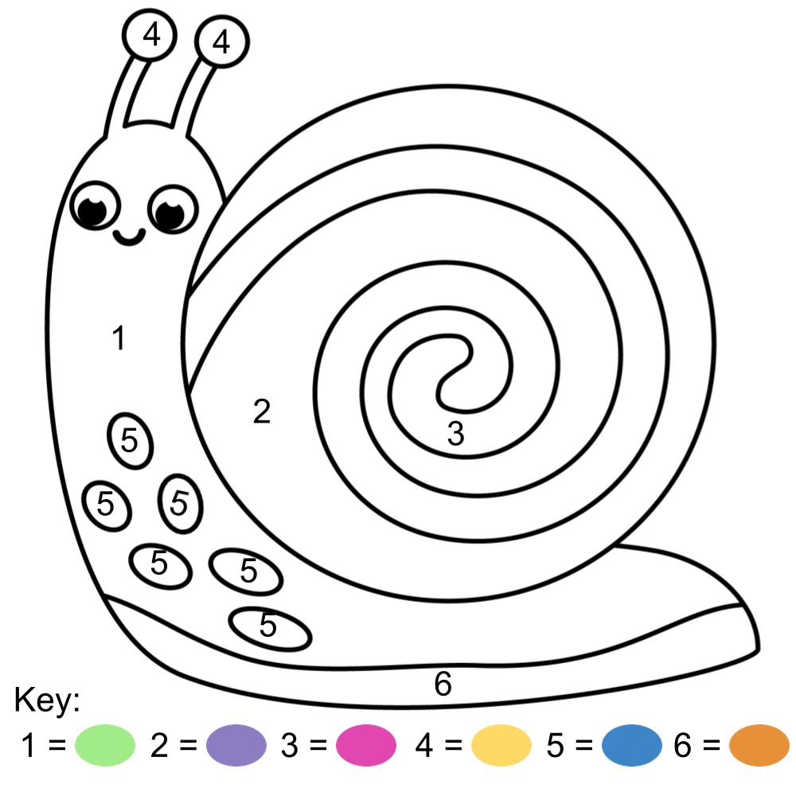
Drawing Level 3

Slide 5
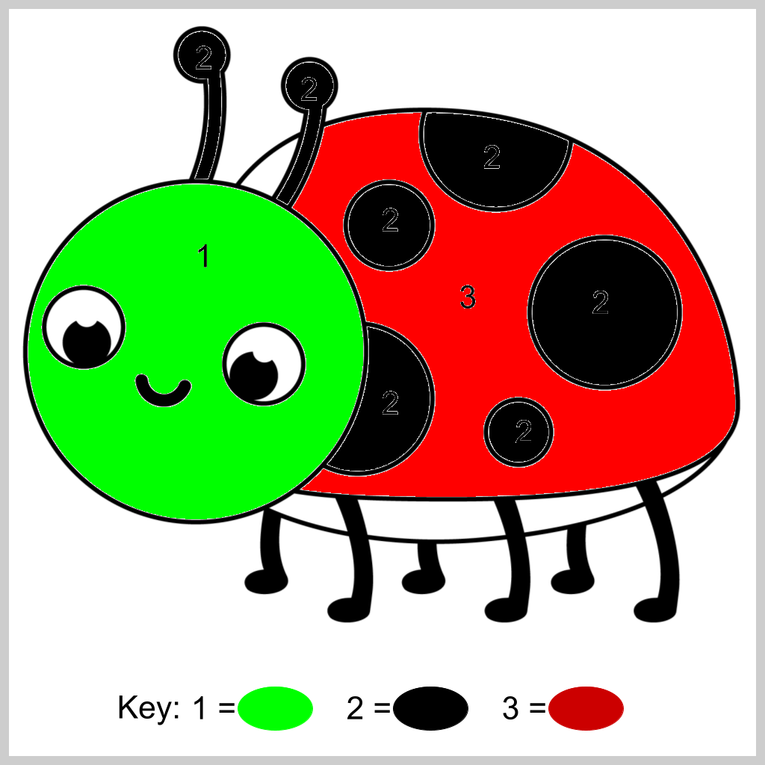
Contoh Hasil Level 1

Slide 6
Link Download Gambar
https://docs.google.com/presentation/d/1_sQJouO3g3DoKggRO5GlxABpLoEG6HIAoSXT5YYfVtM/edit#slide=id.g11b55c955f2_5_3

